Slide 1

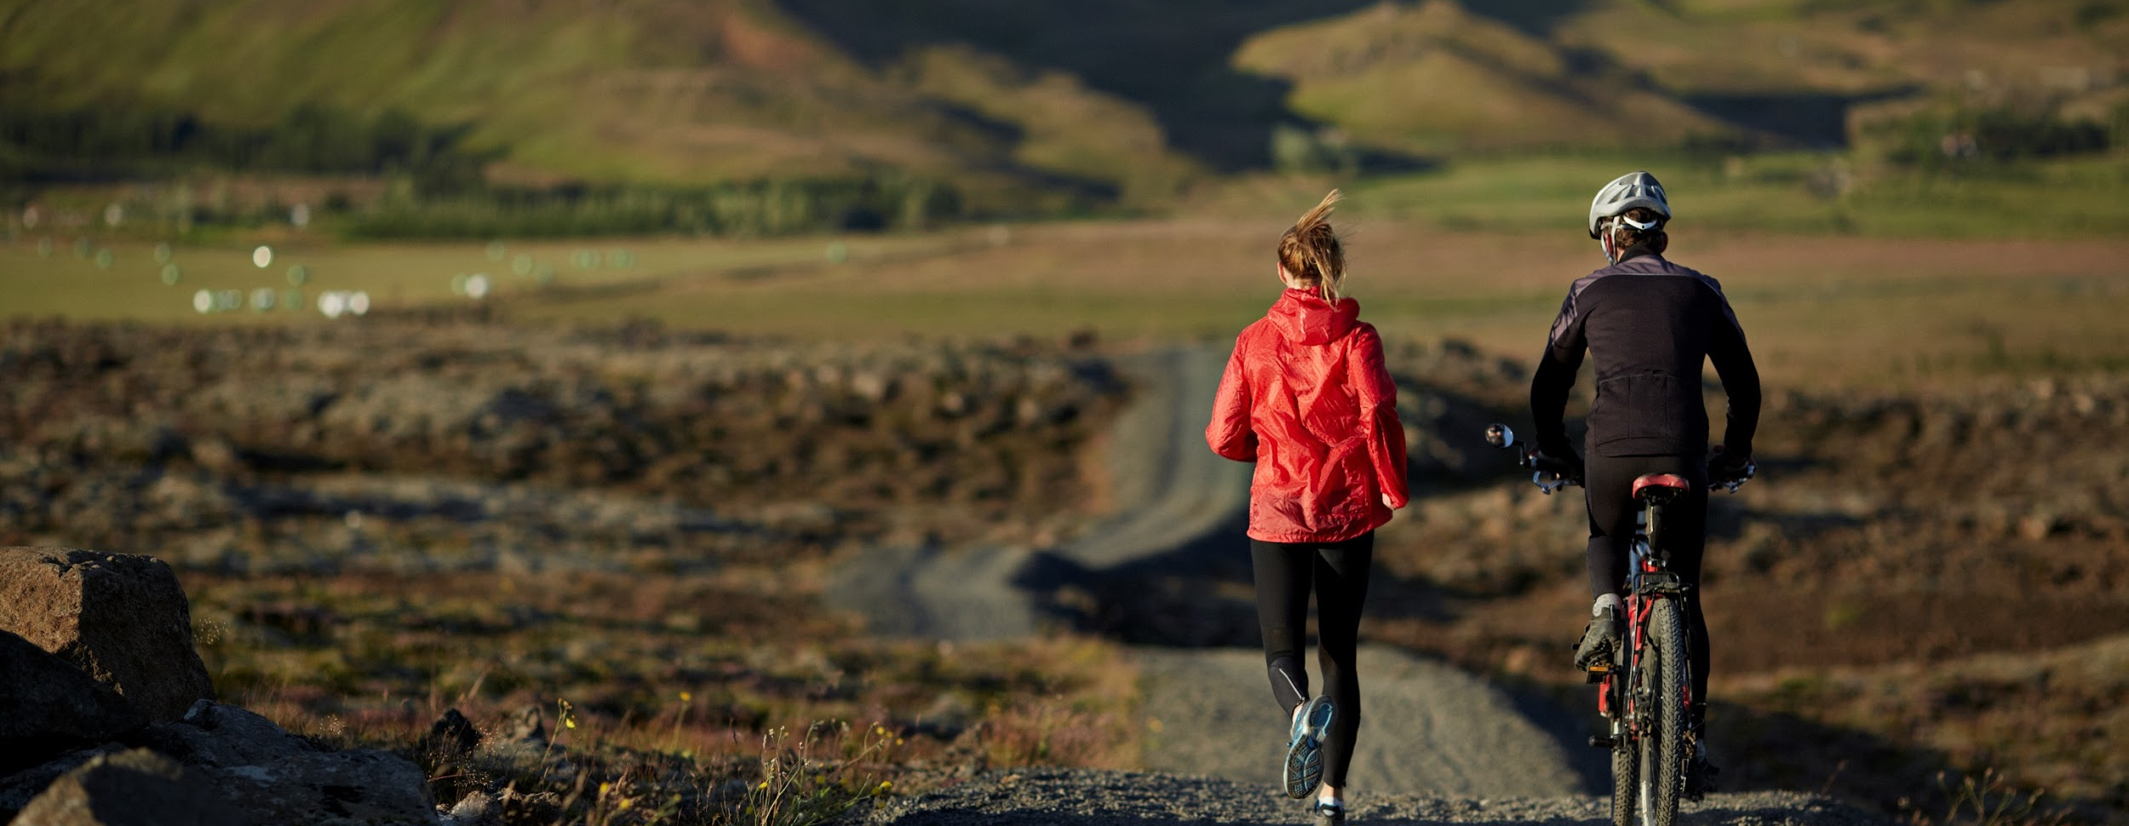


Timberhut Social Network
◤

Slide 2
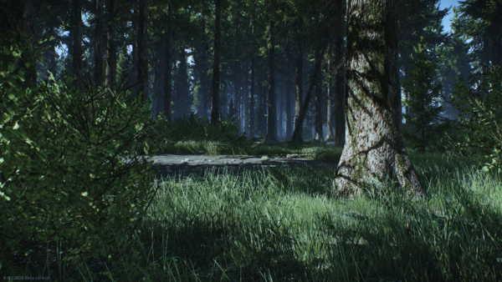



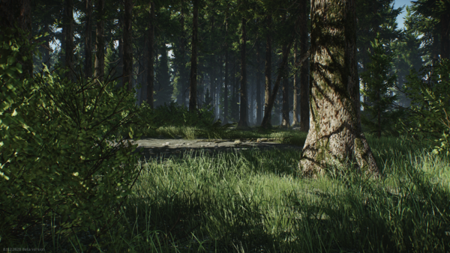
Why Timberhut?
◤
Nowadays we have solutions to almost any daily problems, we can order anything within a click, we can see streaming content everywhere, but we have forgotten one of the main needs humans, which is stay healthy by physical activity.
Right now we have many options for physical activities as the typical sports, gyms, etc. But there's a field within sports that there's no diffusion, these are the Outdoor sports or Outdoor recreation
Swimming
Tennis
Gym

Slide 3
Why Timberhut?
◤
There's a field within sports that there's no diffusion, these are the Outdoor sports or Outdoor recreation, this section of sports is actually really important because besides that they have many goods as being fit, they offer you exclusive benefits as:
being in contact with nature (flora and fauna)
make community with other people
nature's conscience and ecological responsibility
they challenge you not only physical but mentally too because of the constant changing environment

Slide 4
Why Timberhut?
◤
You get vitamin D which is really important for our bodies
Possibility to maintain our forests and green areas with government collaboration (natural reserves)
You don't need a membership

Slide 5

Objective
◤
The main reason to develop this project is to make a positive impact to our community by being the bridge between outdoors sports and people, all with a responsible approach and always promoting good values and healthy habits.
Be the impulse that the growing Outdoors business area needs by making sponsorships and business covenants with the existing enterprises in the field.
We are not here to be a competitor, but to be the cluster of a growing and
successful area as Outdoors is.

Slide 6
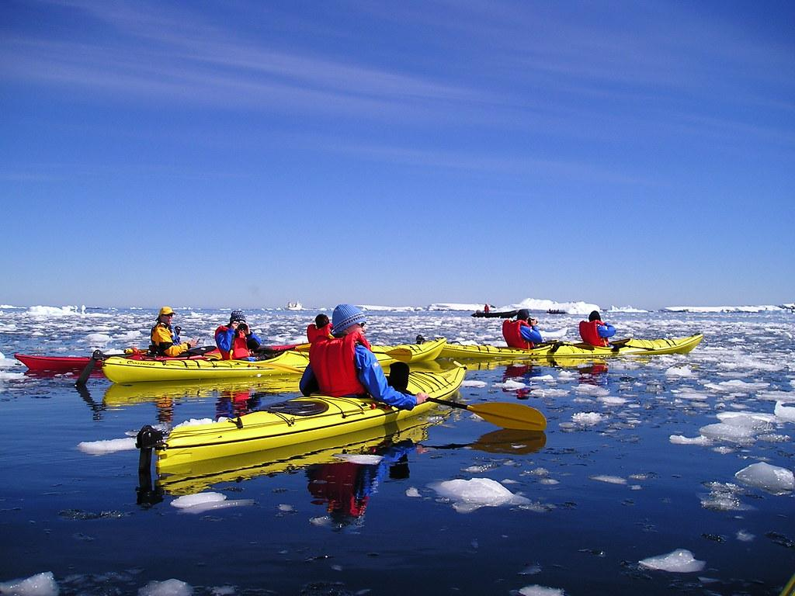
Objective
◤
The main reason to develop this project is to make a positive impact to our community by being the bridge between outdoors sports and people, all with a responsible approach and always promoting good values and healthy habits.
Be the impulse that the growing Outdoors business area needs by making sponsorships and business covenants with the existing enterprises in the field.
We are not here to be a competitor, but to be the cluster of a growing and
successful area as Outdoors is.

Slide 7
What is Timberhut?
This Project is a social network in which it is intended that fans of outdoor sports can share their experiences about the sports of your preference on the social network, in which they can share photos, tips, experiences and the location of the destination they are visiting.
Nowadays we see that outdoor sports is a sector which it is not being given much attention and in which we see potential business that will grow and which we want to be part of.

Slide 8

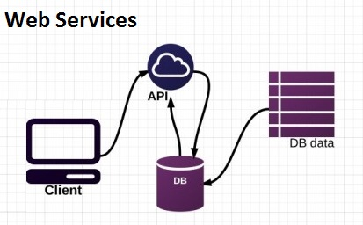




Applied Technologies
Our project has a Rest architecture, we made a Rest API and we consume data with a web application.
In the web application, we used HTML, CSS, Javascript and Bootstrap library.
Server communication was made via HTTP petitions with the API, we used AJAX and Fetch, the last one to send files to the server, like a photo from the user. For the API development we used Java with the framework Spring, which created the layers, to receive petitions, send and receive data, processing data, and connection with the database.

Slide 9



Applied Technologies
For the API development we used Java with the framework Spring, which created the layers, to receive petitions, send and receive data, processing data, and connection with the database.
The management of database was made with MySQL
Google Cloud service was used to store a photo and get a public URL, which is saved on the database to be shown on the web application.

Slide 10

Conclusion
◤
By carrying out this project, we can show that there are many creative ways to solve a problem in the society.
The project arises mainly from the need to promote outdoor activities to the society and for the individuals already involved in outdoor sports, so they can find new places to explore because many times the information of these activities is not available.
We focus on facilitating the access to this informative content in a quick and attractive way through this project, giving a positive impact in this sector by bringing new stakeholders in this area of opportunity that today has not been widely disseminated and we can be the boost that the outdoor sports area needs.

Slide 11


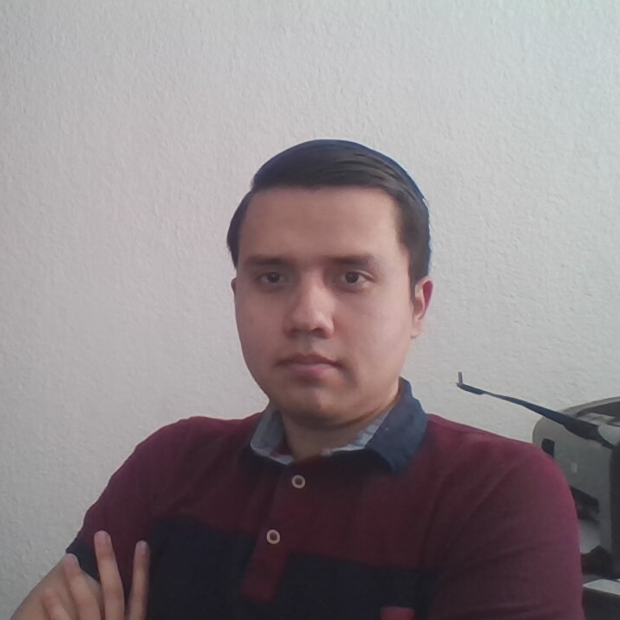
Aquí vamos pero no sé si olga lo pidió.
Iker Arteaga
Director
Alejandro Barbosa
Naiara Padilla
Propietaria

Slide 12
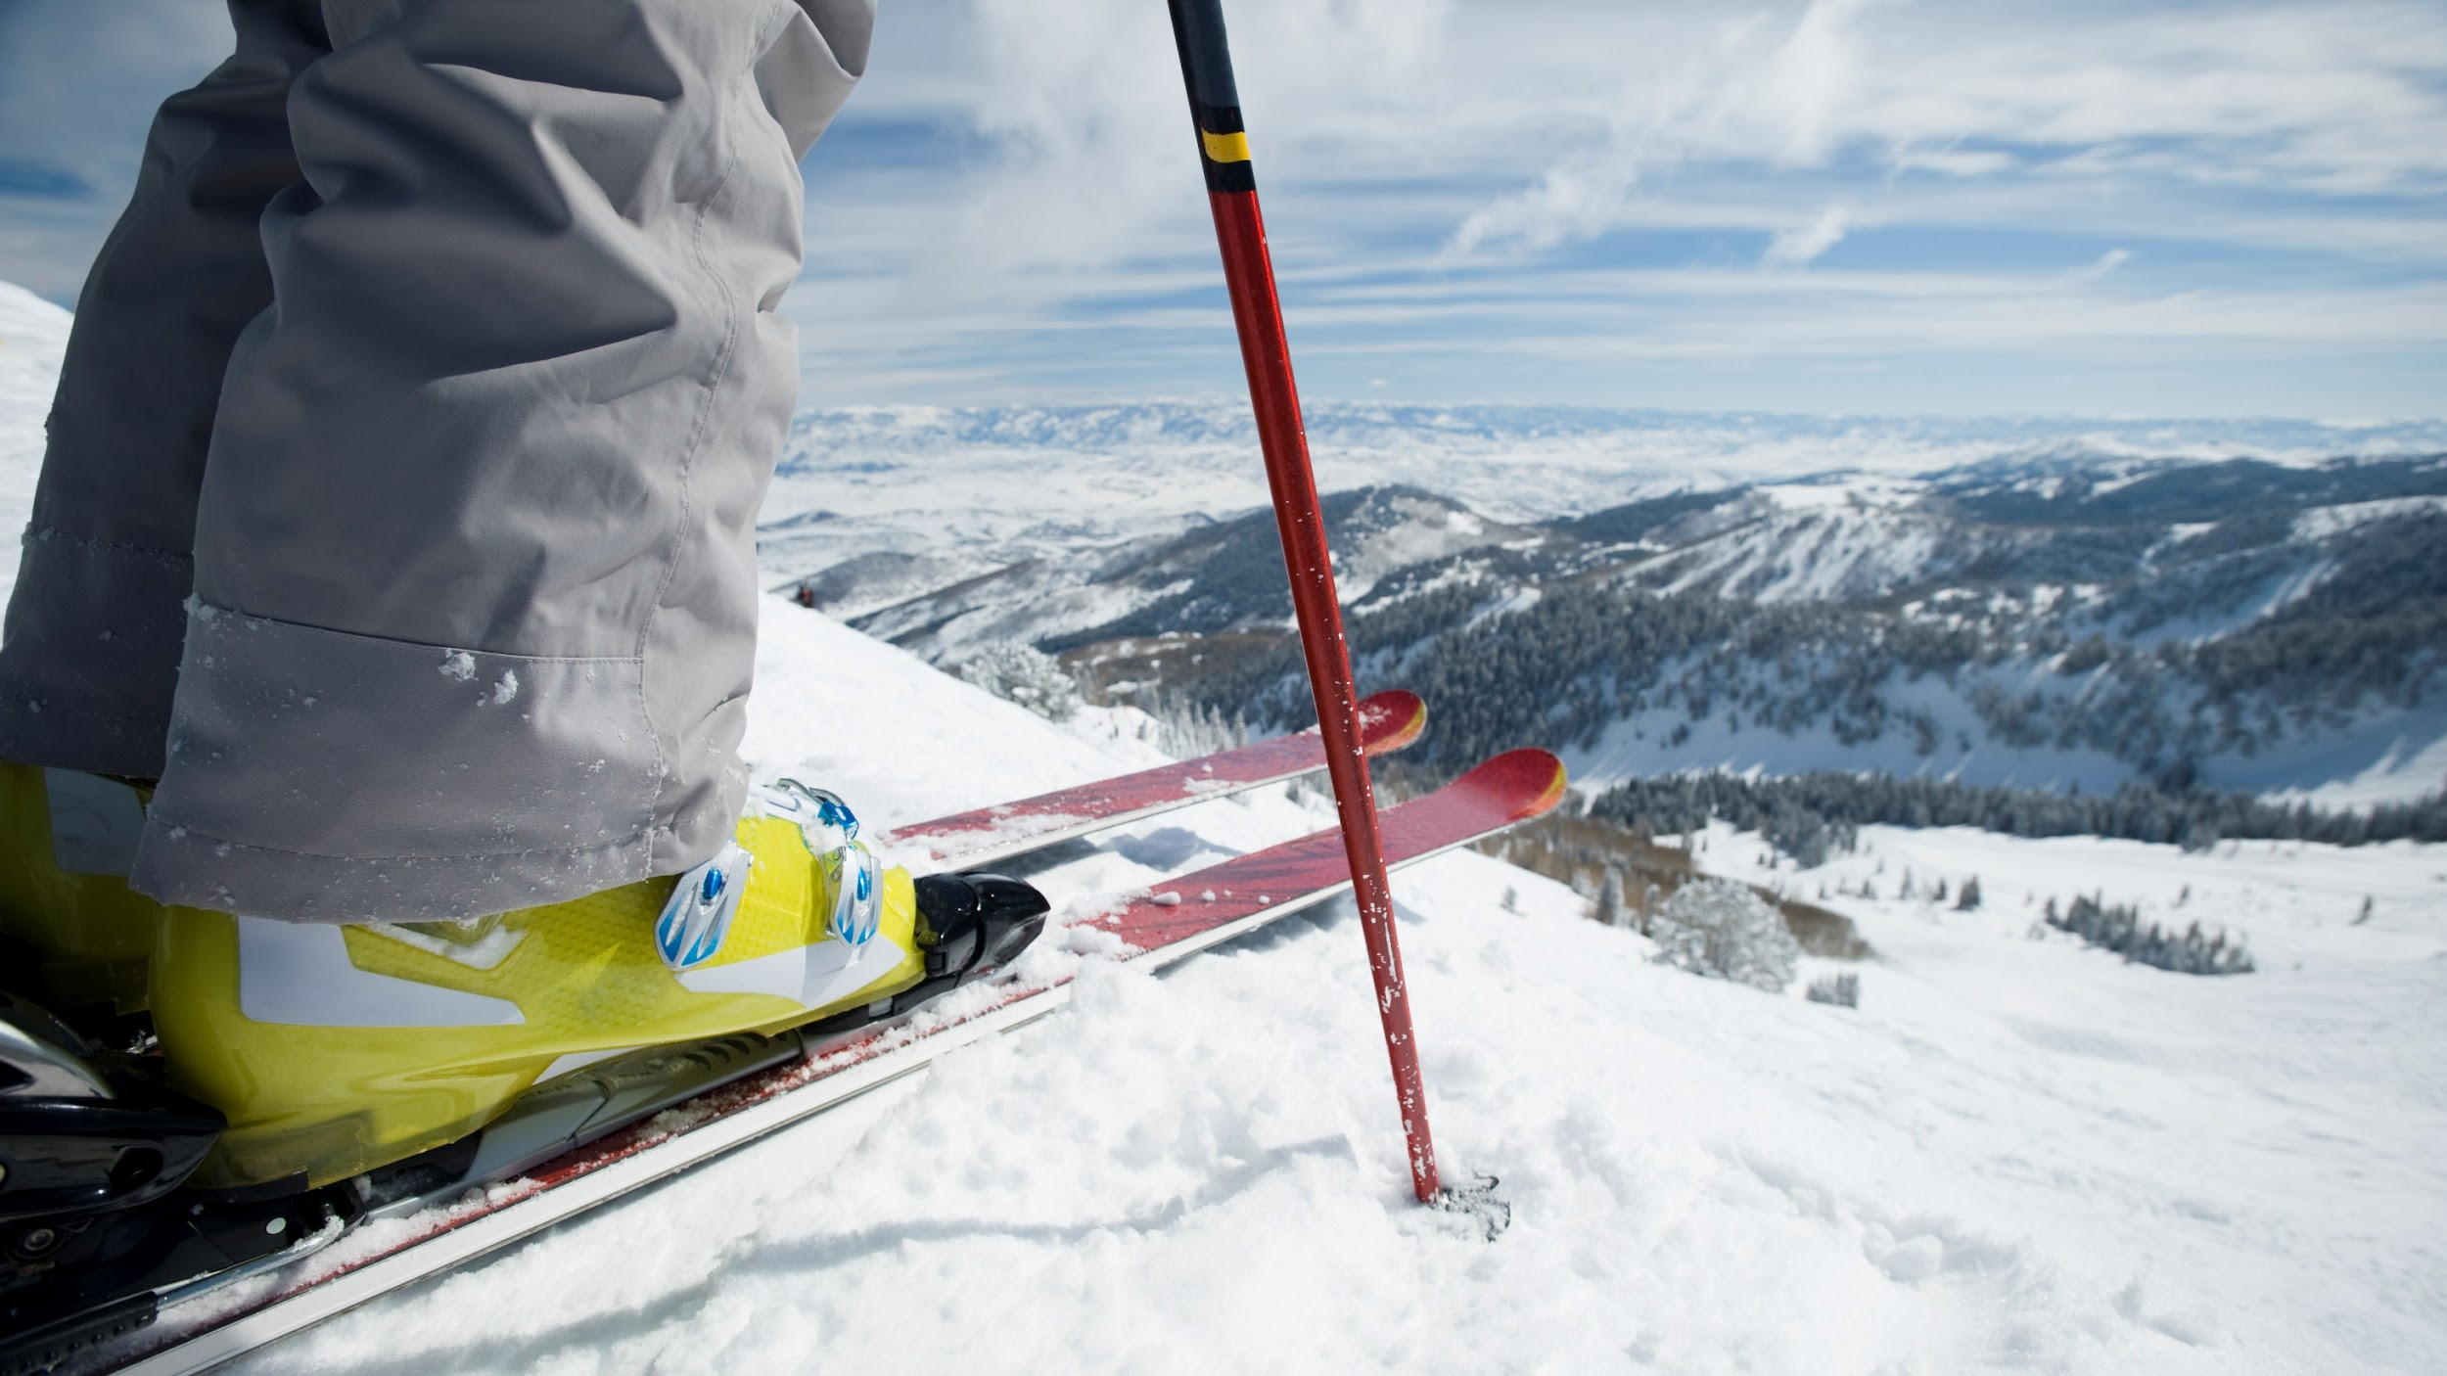
Thank you.
◤
timberhutenterprise@gmail.com

